Slide 1
DISTRIBUTED SHARED MEMORY

Slide 2
What is Distributed Shared Memory?
Distributed Shared Memory (DSM) is a resource management component of a distributed operating system that implements the shared memory model in distributed systems,which have no physically shared memory

Slide 3
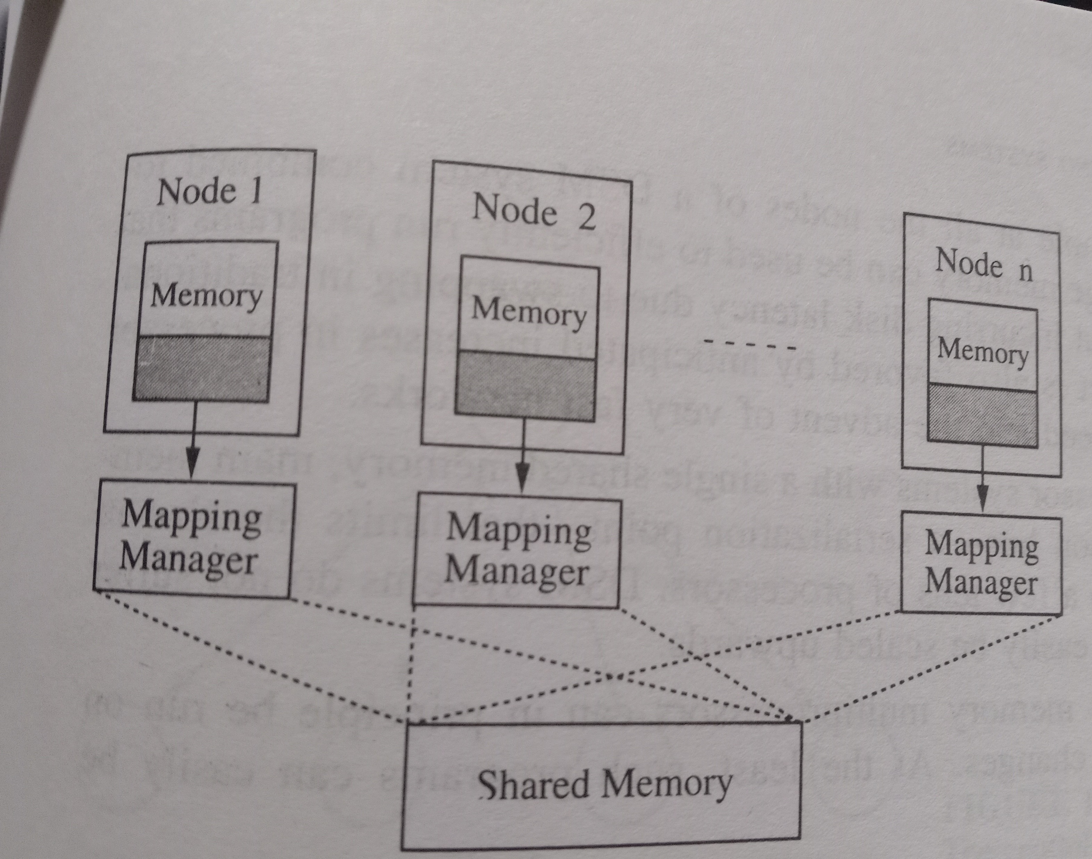

Slide 4
ALGORITHMS FOR IMPLEMENTING DSM
3 CENTRAL ISSUES IN THE IMPLEMENTATION OF DSM
1.How to keep track of the location of remote data
2.How to overcome the communication delays and high overhead associated with the execution of communication protocols in distributed systems when accessing the data.
3.How to make shared data concurrently accessible at several nodes inorder to improve system performance

Slide 5
4 Algorithms
1.The Central – Server Algorithm
2.The migration Algorithm
3.The Read Replication Algorithm
4.The Full-Replication Algorithm

Slide 6
The Central Server Algorithm
A central server maintains all the shared data.
Manages read and write request.
A timeout can be employed to resend the requests in case of failed acknowledgements.
Duplicate write request can be detected by associating sequence numbers with write requests.
To overcome the bottleneck of the central server problem-shared data can be distributed among several servers ie partitioning

Slide 7
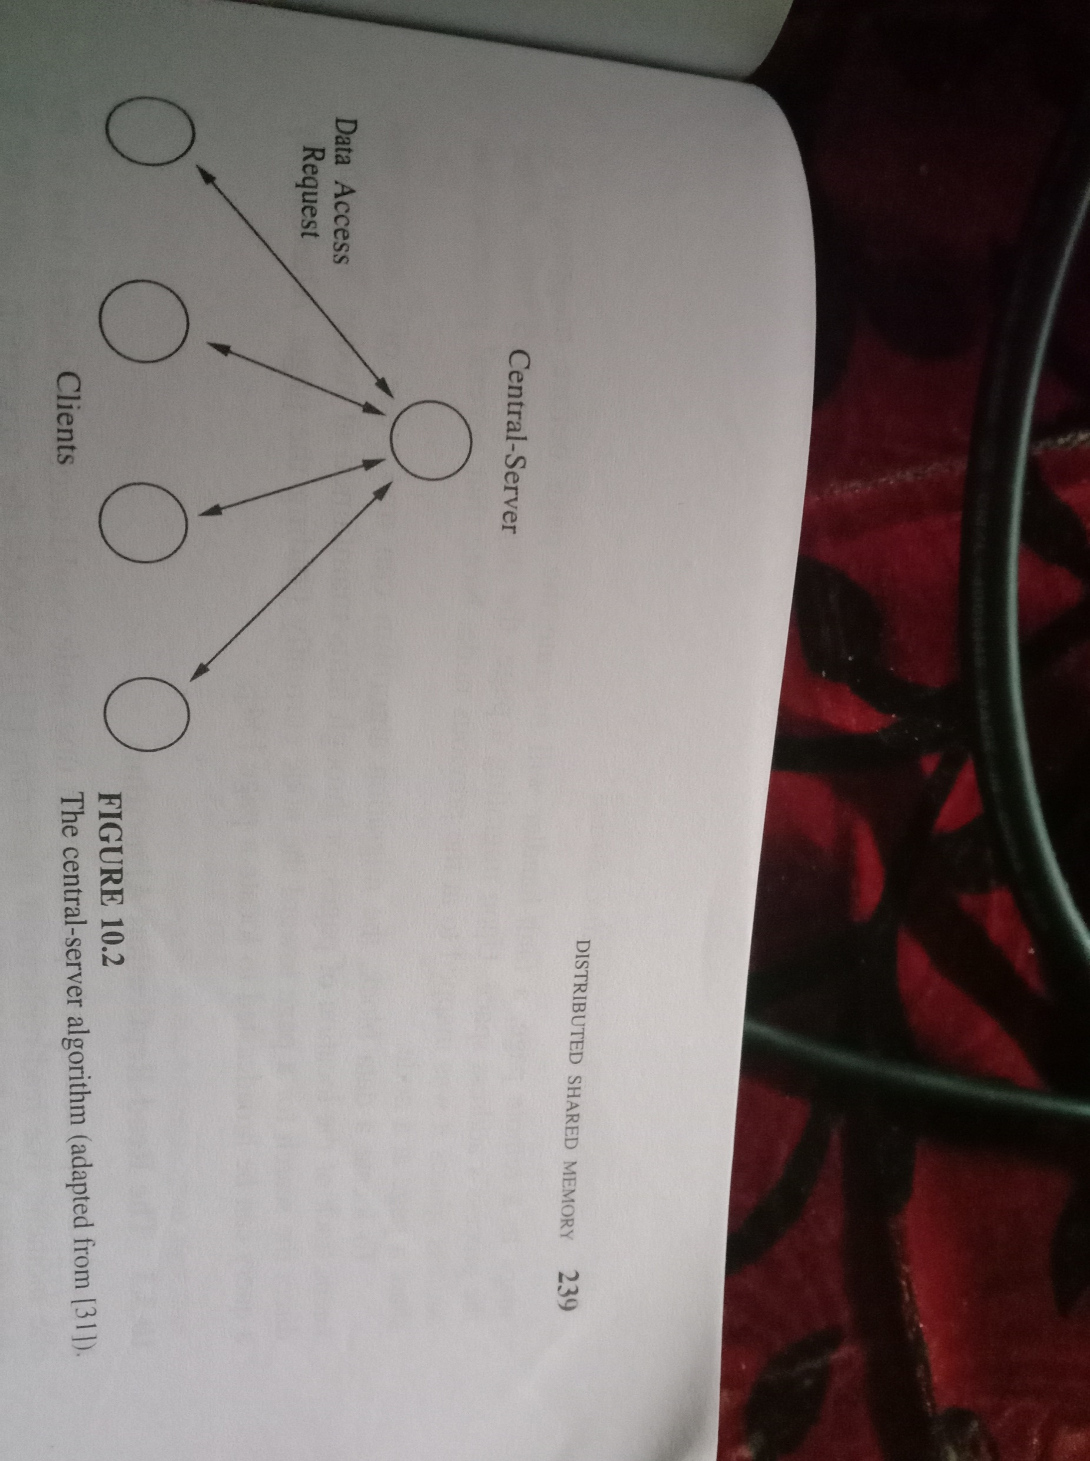

Slide 8
2.The Migration Algorithm

